Slide 1
Sales Forecast Analytics of ABC Manufacturing for 2018-2019
KPMG Capstone Project Bangalore Group C - May 2021
Presented By:
Rana Pratap
Rodrick
Sowjanya Maradana
Pushpa Lata
Sandeep Jain

Slide 2
Table of Contents -:
Background and Purpose 3
Data Preparation 4
State wise
Pesticide Sales Analysis 5
District - Sales Analysis 6
State wise Population Analysis 7
Other factors
Month consumption details 8
Competition 9
Effect of Rainfall on Pesticide Sales 10
Crop Cultivation Effect of the Pesticide Sale 11
Forecast Model
ARIMA Model 12
Exogenous data set - SARIMAX Model 13-14
Holt's method with Additive Trend & Seasonality 15
Conclusion 16
Recommendations 17
End 18

Slide 3
Background and Purpose
In this project, we are analyzing and forecasting the sales of pesticides for a domestic pesticide manufacturing company (ABC Manufacturing) and analyzing variables that impact the sales of the product. This will enable the pesticide company to manage the production to meet growth/slowdown in sales as per the sales forecast.
ABC Specialises in manufacturing and sales of pesticides in various pesticides to be used for agricultural crops. ABC is no 1 of market position with sales of 50 Million (INR) recorded so far.
The following at the points noted –
ABC has good presence in Herbicides, Insecticides and Rodenticides but not Bactericides
Current market position is no 1 however the competitors combined sales outcasts the sales of ABC
Among the products Insecticides amount to 2/3 of sales value with Herbicides and Rodenticides
As a part of strategic initiative, ABC is looking at expanding the market position and sales in this regard is looking to –
Conduct state wise trend analysis of the given sales (refer slide 5 to 7)
To identify other reasons if they are influencing Pesticide sales (refer slide 8 to 11)
To provide state wise forecast of Pesticide sales for ABC Manufacturing (refer slide 12 to 15)
For conclusion and recommendations (refer slide 16 & 17)

Slide 4
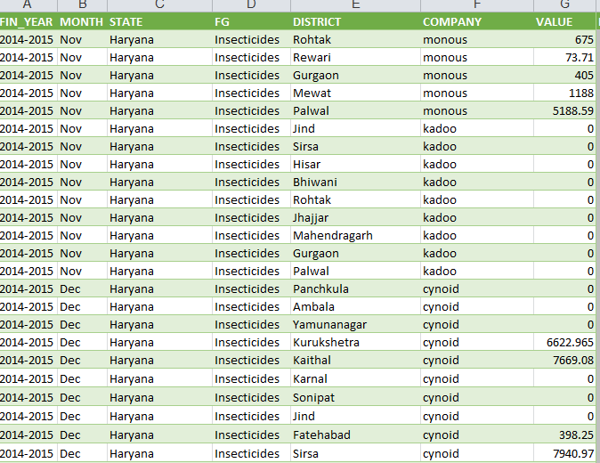
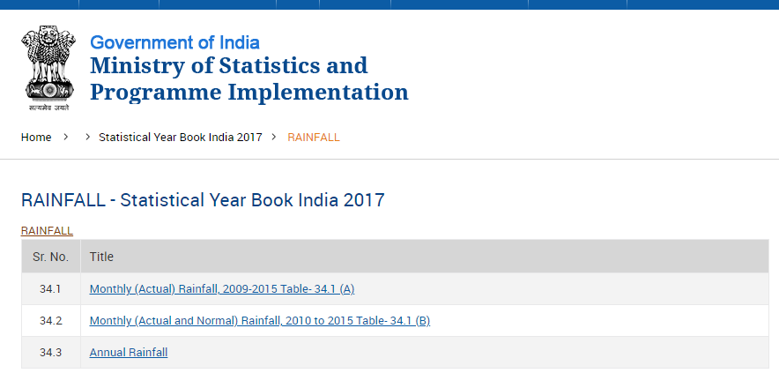
Data Preparation
Basic data for the Pesticide Sales -
The basic data has been processed by the MS Excel file containing 230,153 record of data for the variables – Financial Year, Month, State, FG, District, Company and Value
Additional external data has been obtained for
Crop Production from Directorate of Economics and Statistics, Ministry of Agriculture and Farmer Welfare, GOI
Population for the five states from Census of India website, Wikipedia and other sources not considering year wise data assuming the change percentage as constant
Rain fall data for the appliable time period from India Meteorological Department-Rain fall statistics of India-2018
Handling NA Data
From the data set provided we have observed the data did not have any major NA values
Though quite a few rows of data had Zero values but have been retained for continued flow
Tabular Summary Data for analysis has been Created with MS Excel Pivot for -
ABC v/s Other Company Sales State wise
ABC v/s Others Pesticide Type Sales

Slide 5
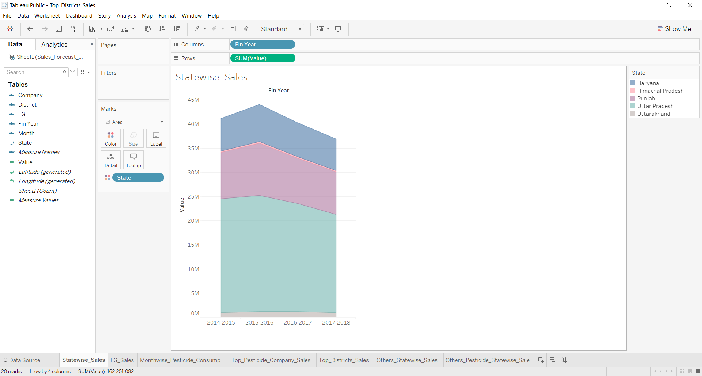
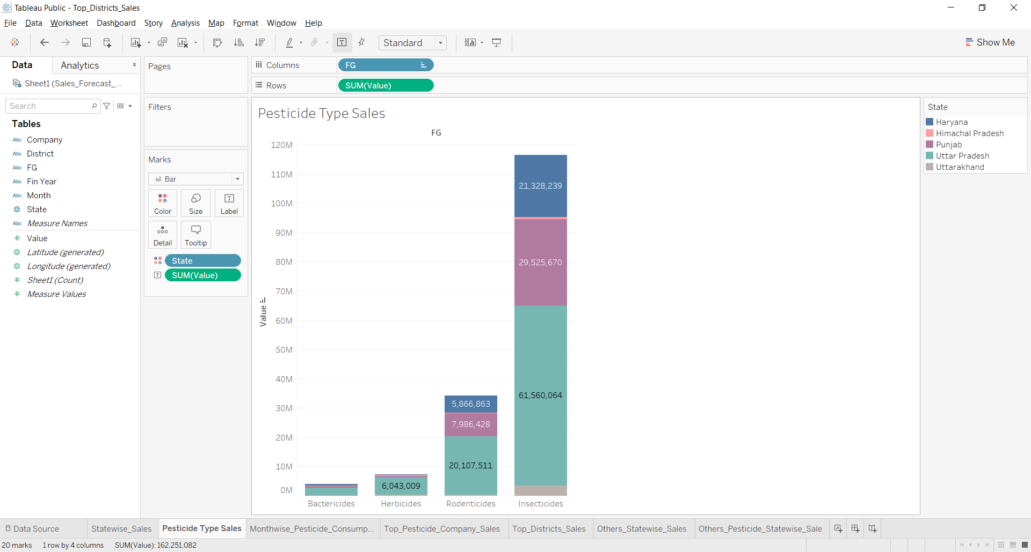
State wise – Pesticide Sales Analysis
State wise Sales
Decreasing tend in consumption of pesticides in general
Himachal and Uttarakhand have low sales value
FG (Pesticide Type) Sales
Insecticides sales amount to more than 50% of overall sales
Bactericides’ sales is promising though its currently of low value
Source – Sales Data Excel Document

Slide 6
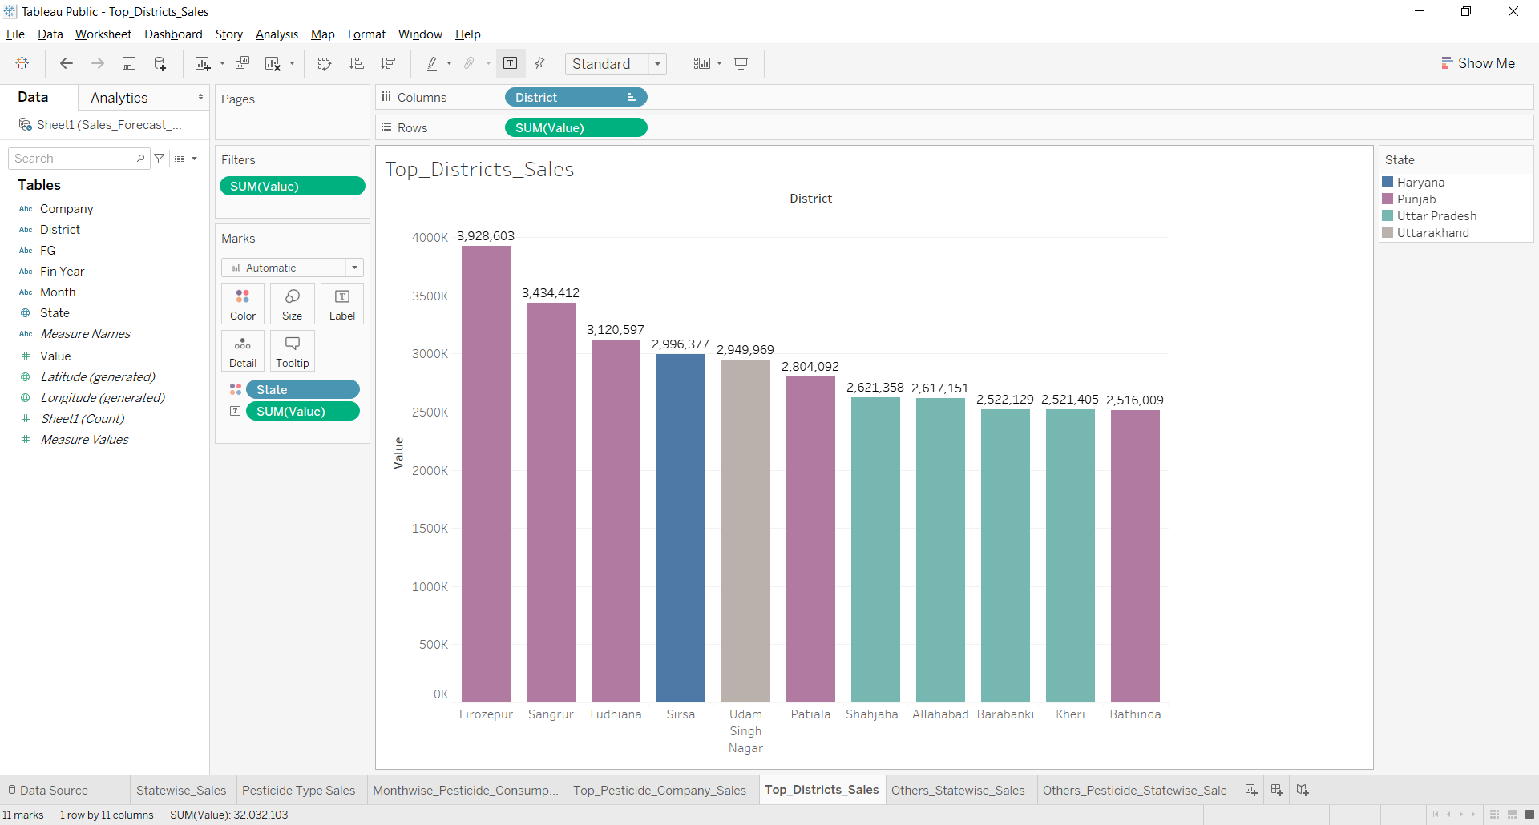
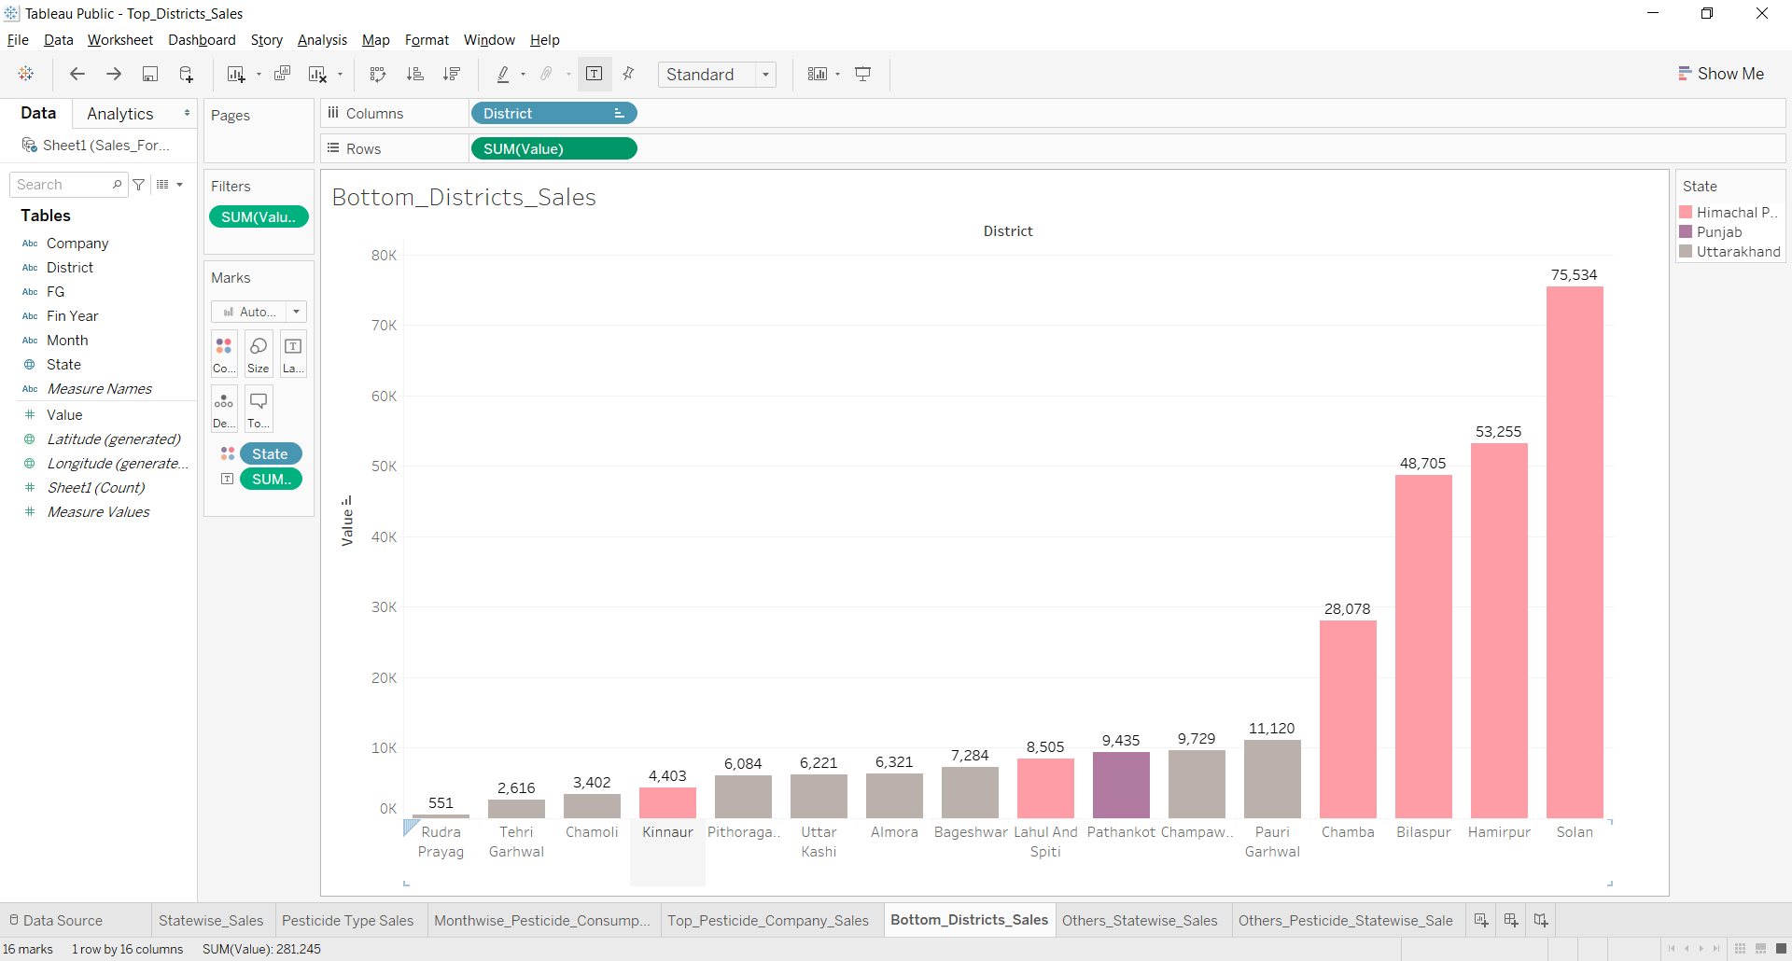
District Sales Analysis
Top District Sales - As we see in the graphs below, highest sales Districts are in Punjab, Uttar Pradesh followed by Haryana and Uttarakhand. The sales here are in excess of 2,500,000 INR. Among these Firozabad, Sangur and Ludhiana are top 3.
Bottom District Sales - We also see many districts in Himachal Pradesh and Uttarakhand where the sales is low. The figures are lesser than 75,000 INR. Indicating there needs to be focus to improve sales.
Source – Sales Data Excel Document

Slide 7
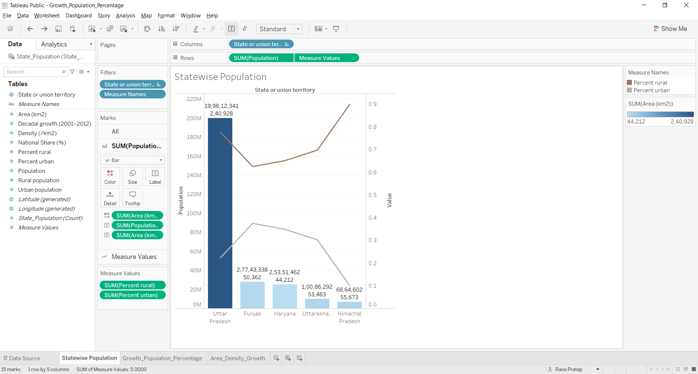
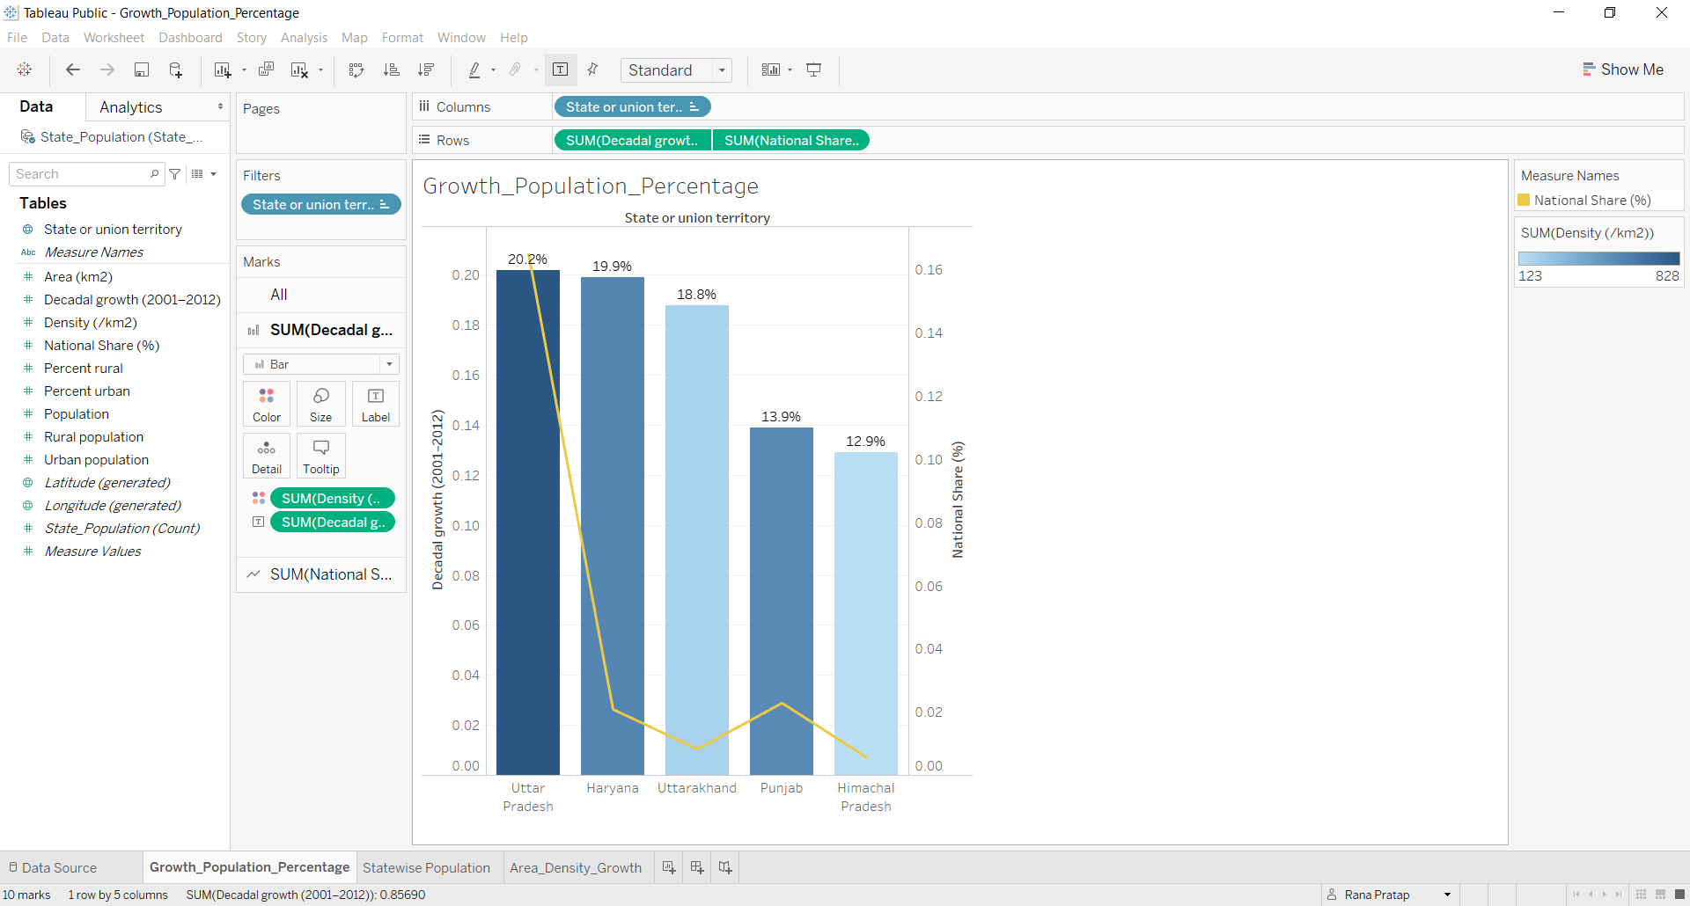
State wise Population Analysis
The below two graphs provide a holistic view of Population distribution figures for the five states.
State wise Population Distribution –
Uttar Pradesh is sum of all the states combined for both, Population and Area (KM²)
The Urban Vs Rural population distribution is very high in UP and Himachal Pradesh
Population Growth and Population Share – Percentages – This metrics is based on the Decadal (2001-2012) growth.
Uttar Pradesh has the highest growth compared to Himachal Pradesh, likewise, the National Share % variation
Population density wise Himachal Pradesh, Uttarakhand, Haryana are low
Source: Census of India, Wikipedia

Slide 8
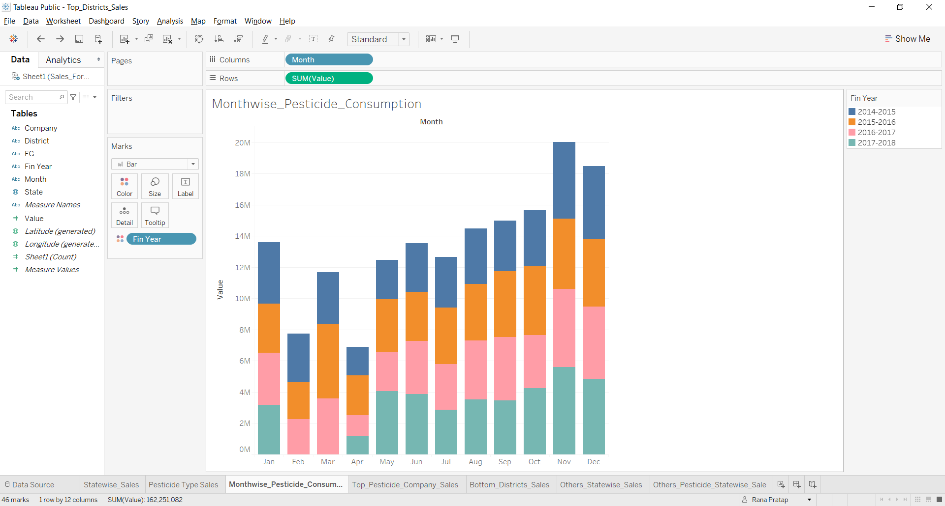
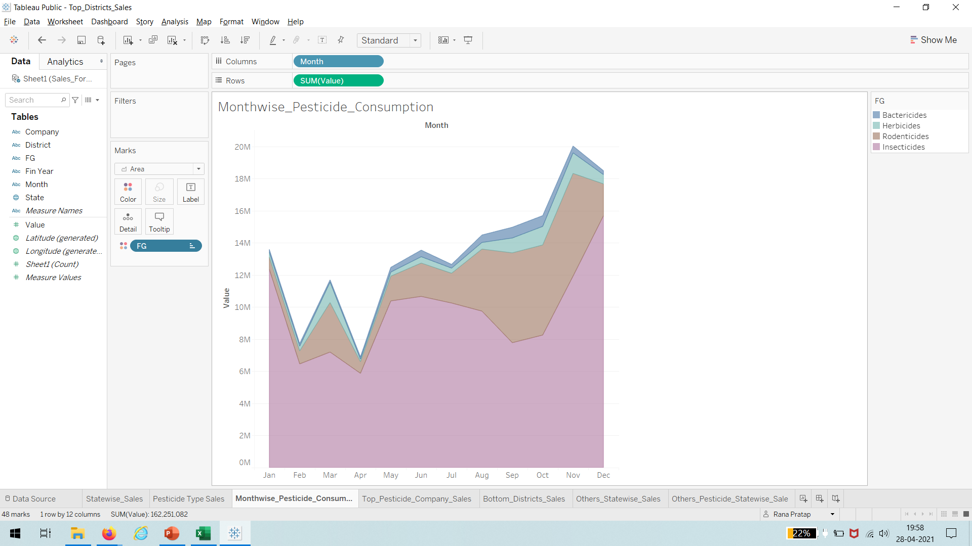
Other factors – Month consumption details
Month wise Pesticide consumption
The graph provides details of pesticides consumption for the specified years –
Kharif Jun to September cycle we see marginal increase from the pre-monsoon season
Rabi cycle Nov to Jan we see the Kharif sales being surpassed dipping there after
Month wise Pesticide Type Consumption
Corresponding to be Kharif/Rabi cycles we have marginal increase of Insecticides and Rodenticides
The volume sales for Herbicides and Bactericides remains constant though
Note: 2018 Feb and Mar data was not available.
Source – Sales Data Excel Document

Slide 9
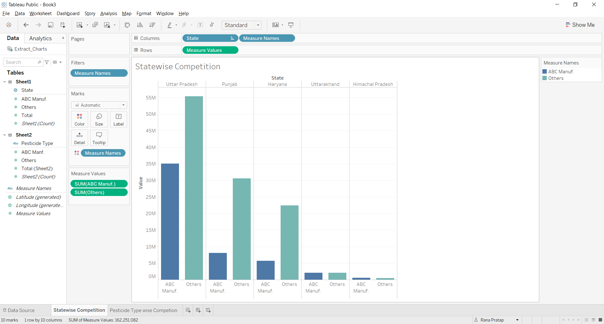
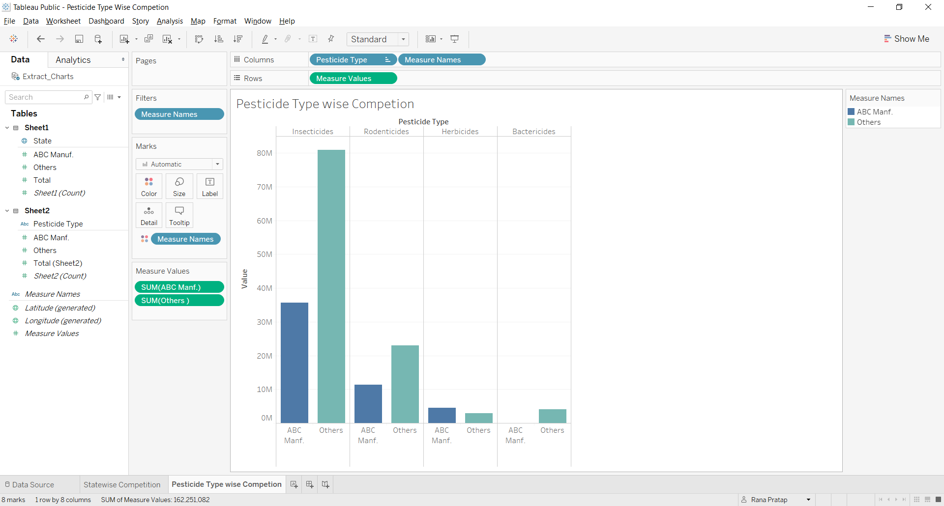
Other factors – Competition
State wise Competition
Uttarakhand, Himachal Pradesh has equal market share
Uttar Pradesh has satisfactory share and opportunity to improve for Punjab and Haryana
Pesticide Type Competition
ABC has lions 2/3rd share in Herbicides’ market
No presence in Bactericides an opportunity to establish here
Insecticides and Rodenticides share is lesser than 50% market share
Source – Sales Data Excel Document

Slide 10
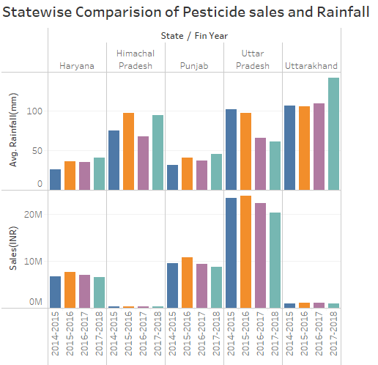
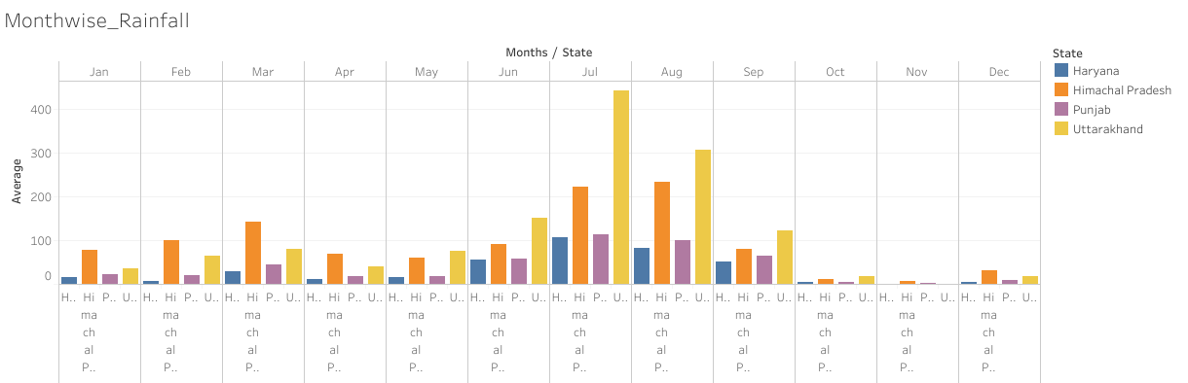
Effect of Rainfall on Pesticide Sales
State wise Comparison:
The graph provides an overview of average rain fall in all states over a given period
Observed high average rain fall in the states Uttarakhand and Himachal Pradesh, which are producing lowest Pesticide sales
Observed Moderate average rainfall in the states Uttar Pradesh and Punjab where the pesticide sales are high
The monsoon [June to September] accounts for 70% of annual rain fall which affects the yield of crop. After monsoon, the consumption of pesticides are in high
Source - India Meteorological Department-Rain fall statistics of India-2018

Slide 11
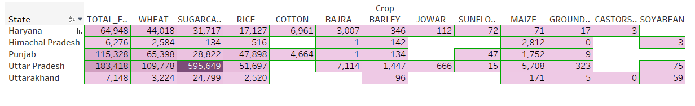
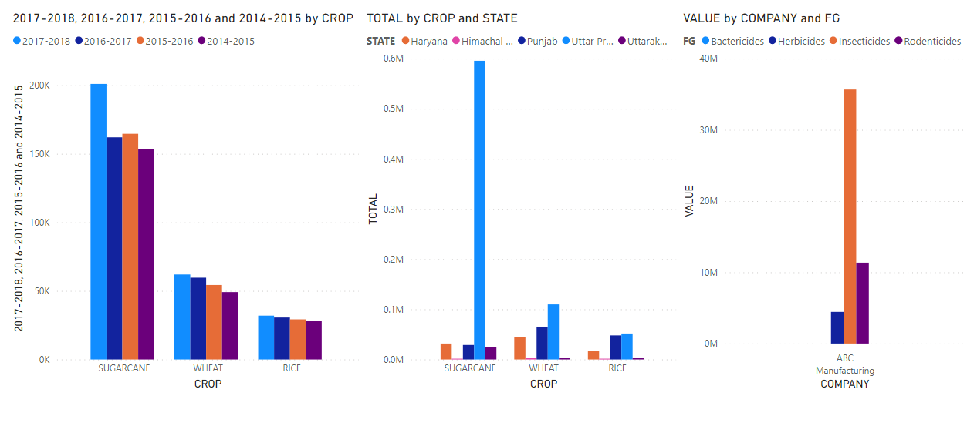
Crop Cultivation Effect of the Pesticide Sale
Total crop production from year 2014 to 2018 (in Tons) of different states affective the consumption of pesticides
3 major production of crop is Wheat, Sugarcane and Rice
The pesticides used for Wheat and Sugarcane is majorly Herbicides and for Rice it is Insecticides
Punjab and Uttar Pradesh are considered the major producer of Wheat, Sugarcane and RICE
Sugarcane is the most grown crop in Utter Pradesh which required Herbicides as an important pesticides to keep the cultivation safe

Slide 12
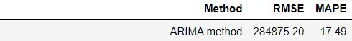
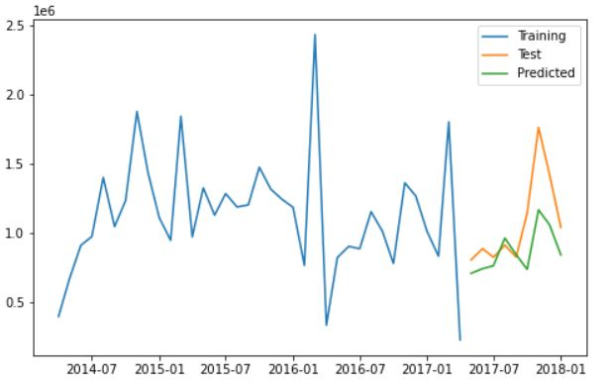
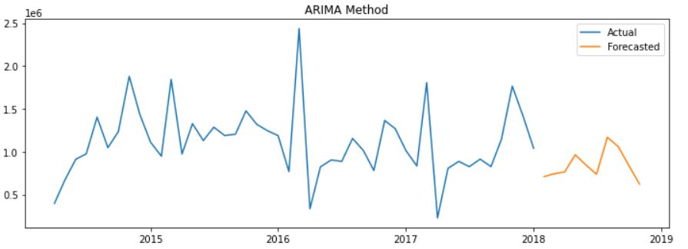
ARIMA Model
We see that ARIMA model has the least error in forecasted values, so we project our data to the near future to know what kind of sales pattern ABC can expect.
p = 1 – the maximum lag polynomial specification
d = 0 is the maximum degree specification
q = 1 is the weighted error
The forecasted data values shows an increase in sales around April through May followed by a drop in June-July
Again, the trend picks up well during August-September
Sales are looking balanced year-round with anticipation of good sales during the Off-Season and Kharif season

Slide 13

Exogenous Dataset (Source: WWW)
Using an additional dataset was based on rainfall analysis of the financial years between 2014 and 2018
The Rainfall data has been merged with the actual data set to get the result through SARIMAX model
Several additional factors like District, State, FG have been removed due to integration issues
Indexes are aligned as per the sales of ABC Manufacturing company
As a part of SARIMAX, we’re going to implement another model to demonstrate the effectiveness of exogenous variables in our dataset.
To identify other reasons if they are influencing Pesticide sales
To provide month wise forecast of Pesticide sales for ABC Manufacturing

Slide 14
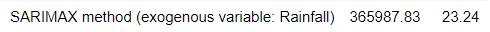
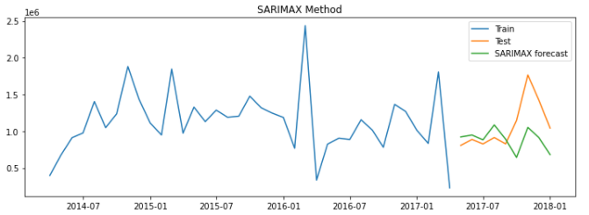
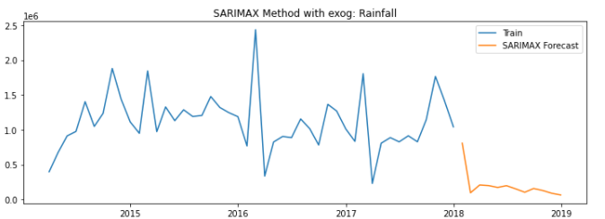
SARIMAX Model
SARIMAX (1,1,1)
AIC: 42.044
p = 1 – the maximum lag polynomial specification
d = 1 is the maximum degree specification
q = 1 is the weighted error
The forecasted data values shows a downward trend in sales Jan-March
Trend picks up during April-July and follows a straight line till September and dips further
Sales are looking disappointing with anticipation of complete loss of sales

Slide 15
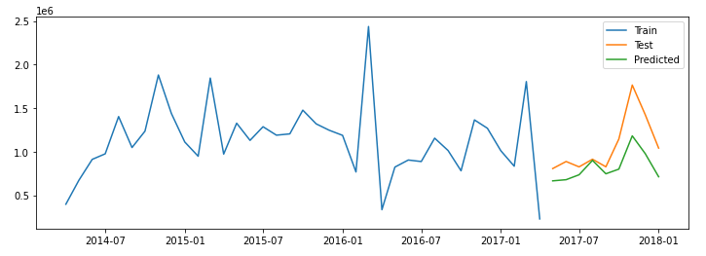

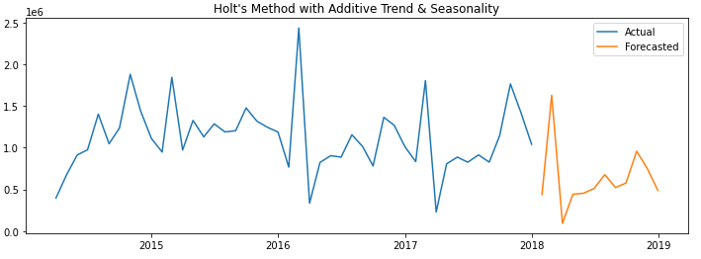
Holt's method with Additive Trend & Seasonality
Holt’s gives more significance to recent observations and Forecast the similar trend as ARIMA model
The forecasted data values shows an upward trend in sales around Jan-Feb followed by a drop in March
Again, There is a constant increase in the trend around March-October followed by drop in year end
The sales are good during Kharif season and Rabi season

Slide 16
In Conclusion
From State wise Pesticide Sales Analysis we can infer -
Marginal decline in Pesticide consumption
Bactericides sales is promising and investment opportunity
From District Sales Analysis
Top districts can also include Haryana, Himachal Pradesh and Uttarakhand
The bottom districts sales can significantly be improved where there is < 75,000 sale
From State wise Population Analysis
Non proportional sales compared to state population is an opportunity
Decadal growth can be considered for future campaigns
From Month consumption details suggest,
Corresponding to Kharif and Rabi seasons marketing pesticides
Segmented focus for various pesticide types
From Competition data analysis -
Opportunity to improve for Punjab and Haryana market shares
Opportunity to establish in bactericides
Improve Insecticides and Rodenticides shares

Slide 17
Recommendations for ABC
From Rainfall data analysis
The Adequate rainfall is having impact on the sales of Pesticides, observed in the states Uttar Pradesh and Punjab.
Heavy rainfall and Low rainfall is not impacting much on Pesticide sales
From State wise Crop Analysis
As per the crop cultivation of different states it can be stated that ABC Manufacturing is selling less Herbicides which is consider to be a major pesticides for Wheat and Sugarcane considering all the states producing high volume of Sugarcane and wheat
Company can make considerable profit by selling Herbicides and Bactericides, as Herbicides’ sales is less and company not making any sales in Bactericides
ARIMA Model
Sales of pesticides is in lieu of the past year trends; the sell is forecasted to be rising in the middle month and drop by the year ending 2018-2019
SARIMAX Model
Sales of pesticides tend to falls drastically in the beginning of the year and stay constant by the end of year ending 2018-2019
Holt's method with Additive Trend & Seasonality
Sales of pesticides tend to increase drastically and drops down in the beginning of the year 2018.Then slowly rises in the middle of the year and followed by drop in the end of year 2018-2019.
As per the test result, we found out that ARIMA model has the least error in forecasting the sales values, therefore, the ARIMA model is best fit for forecasting the sales of the pesticides for the year 2018-2019 of ABC manufacturing company.

Slide 18
Thank You

